Slide 1
IEEE 802.11 as a “component”
Date: 2015-07-12
Authors:

Slide 2
Introduction
This submission is prepared for presentation at a tutorial session of IEEE 802.
The goal is to stimulate discussion on a possible topic of future work in 802.11.
That topic is how a 802.11 STA can be managed by non-proprietary interfaces inside a converged network architecture.

Slide 3
Agenda
802.11 as a component – Adrian Stephens (20 minutes)
  The problem statement
  The current status of 802.11
Intelligent Transport Systems (ITS) as an example of how 802.11 is implemented as a component of a defined system architecture (15 minutes) – Dick Roy
Omniran (IEEE P802.1CF) and its relevance to this topic – Max Riegel (20 minutes)
Discussion (40 minutes) - Adrian
  Q & A – 20 minutes
  Opinion statement – 20 minutes
Wrap and Next Steps (10 minutes)

Slide 4
The problem/opportunity statement
Imagine a future 5G (or later!) network where all access to data from your mobile device passes through an operator core network
  This is one possible future vision.
  Not everybody agrees with this view.
We have failed to provide 3GPP with a standardized means to meaningfully manage and control 802.11 networks.
  Perhaps, as a result, 3GPP have created their own 5GHz technology.
The view of 5G described by NGMN includes usage models that naturally map onto projects in development in 802.11: TGay (60GHz), TGax (High efficiency 1-6 GHz), TGah (900 MHz).
We should want to avoid any impediment for the use of appropriate 802.11 technology in a future 5G network.

Slide 5
What is a component?
For the purpose of this submission, a component has a defined function and defined external interfaces.
The component doesn’t care how it is used, provided that the use of the component matches the constraints of its defined external interfaces.
It should be possible to swap implementations of the component from different sources provided those implementations are compliant to the defined functions and external interfaces.

Slide 6
Is 802.11 a component now?
Answer: No
We have these main impediments:
  No concrete definition of our management interface, defined by various SAP primitives
  A “theoretical” MIB of which there is no compliant implementation.
  Lack of clarity as to whether the SME is part of the STA or not. There are “shall statements” for it, but no adequate interface to control it.

Slide 7
State of the 802.11 MIB
There are no compliant implementations of the 802.11 MIB.
  Our MIB is too big (200 pages) and badly structured
  SNMP has fallen out of favour as a means of network control
The 802.11 MIB’s main value is to define “local variables” used in normative text.
It also defines metrics or control parameters accessed by proprietary interfaces.
Contributors to the MIB through 802.11 amendments frequently lack experience, and drafts have to be coerced into updating the MIB through the MDR process

Slide 8
Value of an abstract management API
An abstract API allows an architectural partition to be specified, in terms of entities, interfaces between entities, and the behaviour of those entities
This partition is not necessarily at the same level of granularity that would be chosen for a practical management API
Because this choice of granularity is left to the implementer, a higher layer network management entity cannot depend on any uniform behaviour to manage.

Slide 9
How does the industry cope now?
The Station Management Entity has its own defined interfaces into the STA. These might match some of the abstract interfaces, but many do not.
It is not possible to construct any workable device by bolting together “off the shelf” components. Instead, the construction of a working device from an 802.11 MAC is more akin to hand-cutting bolts to assemble a fire-arm in the era before Mr Whitworth.

Slide 10
A practical measure of success?
When 3GPP, or whoever defines 5G comes to us and says “can you change your interface to do this”, we want to be able to reply “of course”.

Slide 11
Intelligent Transport System (ITS) as an example of how 802.11 is implemented as a component of a defined system architecture
Dick Roy

Slide 12
What is ITS?
Intelligent Transport Systems (ITS): the application of advanced information and communications technology to surface transportation in order to achieve enhanced safety and mobility while reducing the environmental impact of transportation.
[cf. http://www.its.dot.gov/standards_strategic_plan/#sthash.6p82feaS.dpuf]
Cooperative ITS: a subset of overall ITS that communicates and shares information between ITS stations to give advice or facilitate actions with the objective of improving safety, sustainability, efficiency and comfort beyond the scope of stand-alone systems.
[cf. “Joint CEN and ETSI Response to Mandate M/453” dated 15 April 2010]

Slide 13
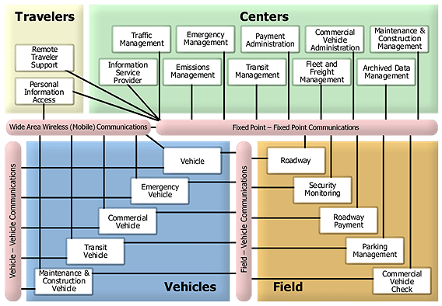
ITS Architecture (“High-level”)
July 2015
[http://www.its.dot.gov/arch/arch_longdesc.htm]
Slide 13
Adrian Stephens, Intel Corporation

Slide 14
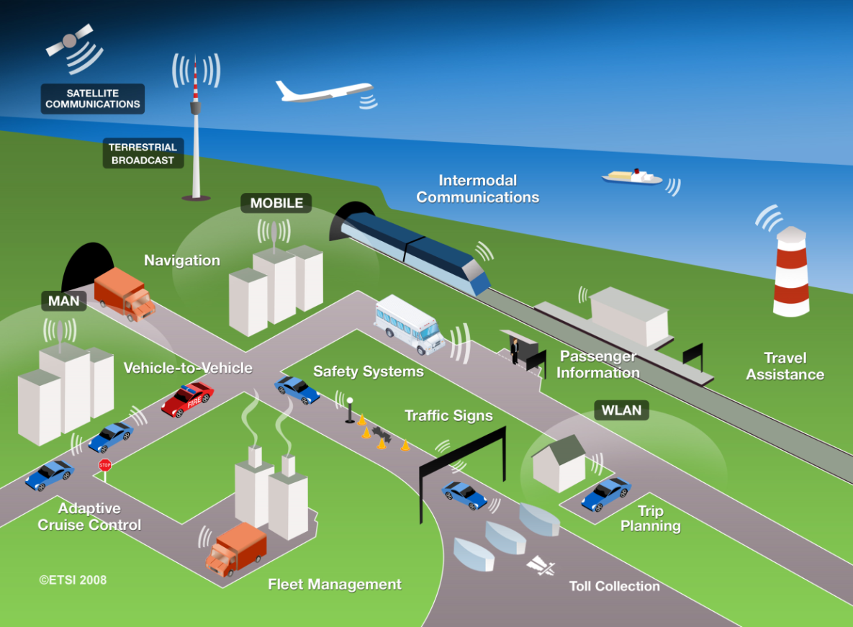
ITS Communications Architecture
July 2015
Slide 14
Adrian Stephens, Intel Corporation

Slide 15
Cooperative Vehicle-Infrastructure Systems (CVIS)
July 2015
The European CVIS project objectives were:
to create a unified technical solution allowing all vehicles and infrastructure elements to communicate with each other in a continuous and transparent way using a variety of media and with enhanced localization;
to enable a wide range of potential cooperative services to run on an open application framework in the vehicle and roadside equipment;
to define and validate an open architecture and system concept for a number of cooperative system applications, …
  [http://cvt-project.ir/En/EnNewsDetail.aspx?SubjectType=99&InfoID=1057]
Slide 15
Adrian Stephens, Intel Corporation

Slide 16
Cooperative Vehicle-Infrastructure Systems (CVIS)
July 2015
The European CVIS project objectives were:
a multi-channel terminal capable of maintaining a continuous Internet connection over a wide range of carriers, including cellular, mobile Wi-Fi networks, infra-red or short-range microwave channels, ensuring full interoperability in the communication between different makes of vehicle and of traffic management systems;
an open architecture connecting in-vehicle and traffic management systems and telematics services at the roadside, that can be easily updated and scaled up to allow implementation for various client and back-end server technologies;
techniques for enhanced vehicle positioning and the creation of local dynamic maps, using satellite positioning, radio triangulation and the latest methods for location referencing;…
[http://cvt-project.ir/En/EnNewsDetail.aspx?SubjectType=99&InfoID=1057]
Slide 16
Adrian Stephens, Intel Corporation

Slide 17

Silo Approach to ITS Service Implementation in Vehicles
July 2015
VM Proprietary
System
EETS
system
eCall
system
Active
Safety
system
Radio box
(3G/LTE, WiFi, Bluetooth, GPS,…)
Radio box
(2G/3G, GPS, 5.8GHz,…)
Radio box
(2G/3G, GPS,…)
Radio box
(GPS, 5.9GHz,…)
Slide 17
Adrian Stephens, Intel Corporation

Slide 18
ITS-S Approach to ITS Service Implementation in Vehicles
July 2015
“Hard”
Safety
System
ITS Station
Parking
EETS
eCall
Comm System
(3G, LTE, WiFi, 5.9GHz, Bluetooth, GPS, …)
Infotainment
VM Proprietary
Firewall
Vehicle HMI
Slide 18
Adrian Stephens, Intel Corporation

Slide 19
ITS station (ITS-S) Architecture
July 2015
[ISO 21217]
Slide 19
Adrian Stephens, Intel Corporation

Slide 20

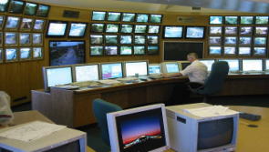
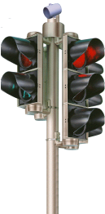
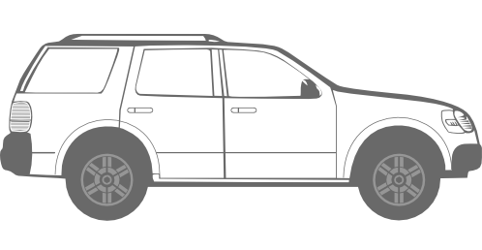

ITS-S Subsystems
July 2015
Personal ITS Station
Central ITS Station
Central
Gateway
Central
Host
Border
Router
Applications
t
t
Applications
n
Facilities
n
Facilities
t
e
y
e
y
m
t
m
t
n
i
i
Facilities
e
r
e
r
e
g
u
g
u
t
y
a
c
a
c
n
n
N
etworking
e
n
N
etworking
&
e
e
N
etworking
y
m
t
a
S
a
S
m
t
&
Transport
...
Transport
...
e
&
Transport
...
i
i
M
M
g
r
r
u
e
a
c
u
n
e
g
a
S
a
c
Access
Access
M
Access
n
N
etworking
e
Ethernet
Technologies
CAN bus
Technologies
Technologies
a
&
Transport
...
S
Ethernet
Ethernet
IPv
6
M
Traffic Centre/Service Centre
Access
3
Technologies
Communication
Networks
Vehicle ITS Station
Roadside ITS Station
5.9
Mobile
Router
Vehicle
Host
Vehicle
Gateway
Roadside
Gateway
Access
Router
Roadside
Host
Border
Router
t
Applications
t
Applications
n
Facilities
n
Facilities
e
y
e
y
m
t
m
t
t
Facilities
t
Facilities
i
i
n
n
e
r
e
r
e
e
y
t
u
u
y
n
g
c
g
c
m
t
m
t
e
N
etworking
a
N
etworking
&
a
N
etworking
e
i
e
i
y
n
e
n
e
r
t
r
t
m
Transport
...
t
...
S
...
S
g
u
n
g
u
&
i
a
Transport
a
&
Transport
e
c
n
e
r
M
M
ECU
a
N
etworking
c
m
N
etworking
y
a
N
etworking
&
e
e
N
etworking
g
u
n
e
t
y
c
S
i
n
S
m
t
a
ECU
a
&
Transport
...
e
&
Transport
...
r
a
Transport
...
...
i
n
e
M
g
u
M
e
&
Transport
r
a
S
a
c
g
u
M
Access
Access
Access
n
e
a
c
Technologies
Technologies
a
S
n
e
Technologies
Access
M
Access
Access
a
Access
S
Technologies
5
.
9
Technologies
Technologies
M
Technologies
Ethernet
CAN bus
GHz
Ethernet
Ethernet
Ethernet
IPv
6
Ctrl
SENS
Loop Detector
[ISO 21217]
Slide 20
Adrian Stephens, Intel Corporation

Slide 21
ITS-S Architecture and Standards
July 2015
ITS-S
Manager
ISO 24102
SAP
SAP
Null-networking and transport protocols | IPv6 Networking and transport protocols
ISO 29281-1 | ISO 21210
SAP
SAP
SAP
SAP
SAP
SAP
SAP
SAP
SAP
SAP
SAP
ISO 21218
ISO 21218
ISO 21218
ISO 21218
ISO 21218
ISO 21218
ISO 21218
ISO 21218
ISO 21218
ISO 21218
SAP
ISO 21212
ISO 21213
ISO 21214
IR
Manager
ISO 21215
W-LAN
Manager
ISO 21216
Millimeter
Manager
ISO 24103
ISO 24xxx
W-MAN
Manager
ISO 24xxx
Broadcast
Manager
ISO 24xxx
PAN
Manager
ISO 24xxx
Wired
Manager
2G Cell
Manager
3G Cell
Manager
DSRC
ISO15628
…
GPRS
EDGE
…
cdma2k
UMTS
…
IR-B
IR-A
…
WiFi
M5
RADAR
MM-J
MM-E
K-DSRC
J-DSRC
C-DSRC
…
HC-SDMA
WiMAX
…
DAB
GPS
…
W-USB
BlueT
Ether
AMIC
CAN
TC204 Media
External Media
ISO 21218 = LSAP
SAP
Data SAP
SAP
Management SAP
Slide 21
Adrian Stephens, Intel Corporation

Slide 22
ITS-S / WAVE Device Manufacturers
(w/ one or more 802.11 CIs)
July 2015
AradaSystems
Autotalks
Cohda Wireless
Commsignia
Denso
Essys
Imtech
ITRI
Kapsch
Lesswire
Q-Free
Ranix
Savari Networks
…
Slide 22
Adrian Stephens, Intel Corporation

Slide 23
For More Information
July 2015
http://its-standards.info
http://www.iteris.com/cvria
http://www.its.dot.gov
Slide 23
Adrian Stephens, Intel Corporation

Slide 24
Omniran (IEEE P802.1CF) and its relevance to “802.11 as a component”

Slide 25
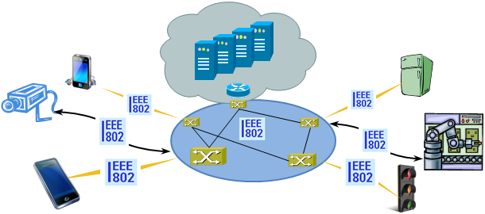
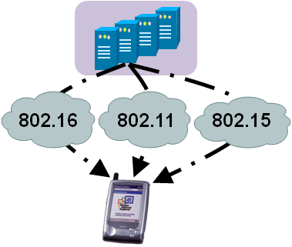
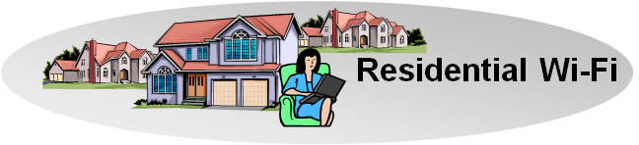
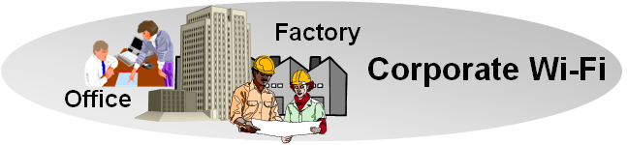
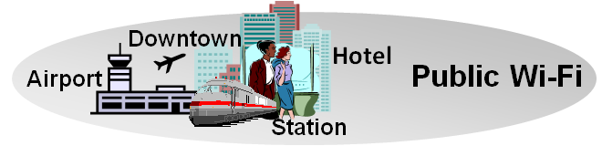
There is Evidence to consider Commonalities of IEEE 802 Access Networks
More (huge) networks are coming
up by everything gets connected
  e.g. SmartGrid, ITS, IoT, …
New markets for
IEEE 802 access technologies
  e.g. factory automation, in-car communication, home automation, …
IEEE 802 access is becoming more heterogeneous
  multiple network interfaces
    e.g. IEEE 802.3, IEEE 802.11, IEEE 802.15…
  multiple access network topologies
    e.g. IEEE802.11 in residential, corporate and public
  multiple network subscriptions
    e.g. multiple subscriptions for same interface
New emerging techniques, like SDN and virtualization

Slide 26
P802.1CF develops a functional description of a generic IEEE 802 access network
‘External’ requirements from the
service/deployment perspective
Develop a logical/functional model
for evaluation of those requirements;
Available IEEE 802 specifications
of protocols and attributes.
?
A functional network specification based on an abstract network model supports evaluation and better understanding of existing IEEE 802 protocols for deployment in access networks.
It illustrates commonalities among IEEE 802 access technologies while supporting specifics of individual technologies.
The common model facilities deployment of IEEE 802 technologies.

Slide 27

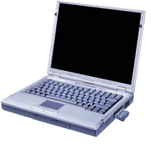

Access network views
The physical view of an access network
Subscription
Service
Information
Server
Terminal
Access Network
Backhaul
Access Router
Protocol layer architecture of an access network
Application
Application
Transport
Transport
Network
Network
Network
Network
Data Link
DL
DL
DL
DL
DL
DL
Data Link
Data Link
Data Link
Physical
Phy
Phy
Phy
Phy
Phy
Phy
Physical
Physical
Physical
Medium
Medium
Medium
Medium
Medium
Terminal
Interface
Node of
Attachment
Backhaul
Access Router
Interface
Scope of P802.1CF
STA
AP

Slide 28
P802.1CF Network Reference Model
Subscription
Service
Coordination and Information
Service
R2
R10
R4
R11
TE Ctrl
AN Ctrl
AR Ctrl
R8
R9
Terminal
Interface
R5
R7
Access Router
Interface
NA
Backhaul
R1
R6
R3
Terminal
Access Network
Access Router
STA
AP
NA = Node of Attachment {AP, BS}

Slide 29
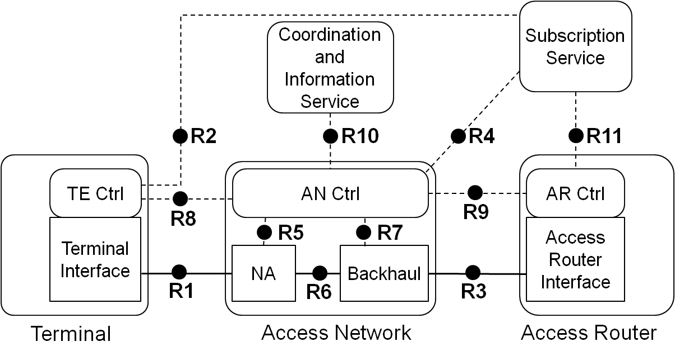
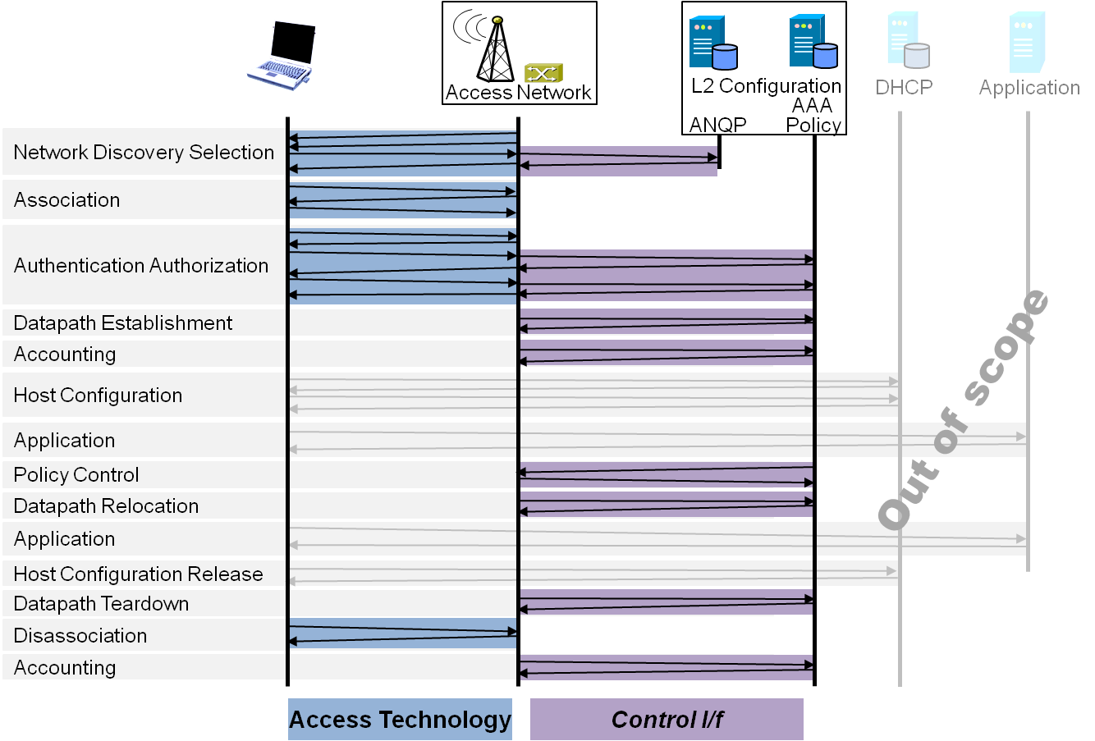
P802.1CF Draft ToC
Introduction and Scope
Abbreviations, Acronyms, Definitions, and Conventions
References
Identifiers
Network Reference Model
  Overview
  Reference Points
  Access Network Control Architecture
    Multiple deployment scenarios including backhaul
Functional Design and Decomposition
  Dynamic Spectrum Access
  Network Discovery and Selection
  Association and Disassociaiton
  Authentication and Trust Establishment
  Datapath establishment,
  relocation and teardown
  Authorization, QoS and policy control
  Accounting and monitoring
SDN Abstraction
Annex:
  Privacy Engineering
  Tenets (Informative)

Slide 30
P802.1CF provides an abstract network model for IEEE 802
Application view
  Guides deployment of IEEE 802 technologies
Components
  Defines abstract functional entities of IEEE 802 technologies
    E.g. Node of Attachment, Backhaul, TE/AR Interface
Generic
  Emphasizes commonalities among IEEE 802 technologies
    E.g. MAC Service, EAPoL, LMI
Software oriented
  Creates data models for IEEE 802 access network and components.
  In OO terms: Definition of classes for ‘access network’, ‘na’, ‘backhaul’
Extensible
  Provides basic/generic data structures for extension by technology specifics

Slide 31
802.1CF facilitates …
Privacy engineered access network
  When the data in the access network is well defined, sensible parts of it can be protected.
Software Defined Networking
  SDN gets an abstract model of a whole ‘access network’
Access network virtualization
  It is easy to create multiple instances from a class definition
Derivation of adapted network models for other kind of user plane transport
  E.g. Cable/DSL or NA directly attached to access router

Slide 32
What 802.1CF can do for
IEEE 802.11 as a ‘component’
Describing IEEE 802.11 as a ‘component’ would require a
  Deployment models
  A control architecture, i.e. definition of entities exchanging control information with the ‘component’
  An outline for the specification of the functional behavior from an application perspective
  Restructuring the IEEE 802.11 control attributes from an application perspective
802.1CF would provide the solution for 1), 2), 3)
  Reinventing the wheel may lead to something quite similar to 802.1CF
It would be left to 802.11 to develop an appropriate format of its LMI (Layer Management Information (MIB))

Slide 33
A practical measure of success?
When 3GPP, or whoever defines 5G comes to us and says “can you change your interface to do this”, we want to be able to reply “of course, we can show you, how you can adopt our technology to your system”.

Slide 34
Thank you for your attention.
Any questions for clarification on P802.1CF?

Slide 35
Key Discussion Points
Is this really an IEEE 802 / 802.11 standards issue?
Relevance of IEEE P802.1CF
Relevance of IEEE 802.21
Relevance of ISO/CEN/ETSI standards
Who are the customers for this interface?
Are we trying to manage the AP or the non-AP STA?
How do we sustain the ability of implementers to differentiate?
What is the level of granularity of control?

Slide 36
Straw Poll 1
Do you believe there need to be standardized interfaces for the control and management of IEEE 802.11?
Yes
No
Abstain

Slide 37
Straw Poll 2
Should IEEE 802.11 work on standardized interfaces for management and control of IEEE 802.11?
Yes
No
Abstain

